Slide 1


Welcome to
York St John
University

Slide 2


Slide 1
Content here

Slide 3


Slide 2
Content here

Slide 4

Slide 3
Content here

Slide 5

Slide 5
Content here

Slide 6
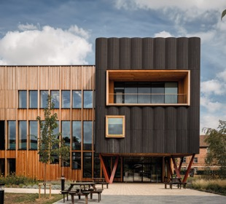
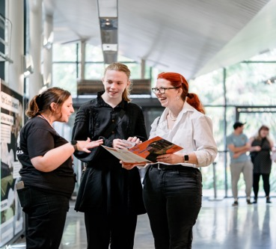

Slide 6
Content here

Slide 7


Slide 7
Content here

Slide 8

Slide 8
Content here

Slide 9

Slide 9
Content here

Slide 10

Slide 10
Content here

Slide 11

Slide 11
Content here

Slide 12

Slide 12
Content here

Slide 13

Slide 13
Content here

Slide 14

Slide 14
Content here

Slide 15

Slide 15
Content here

Slide 16

Slide 16
Content here

Slide 17

Slide 17
Content here

Slide 18

Slide 18
Content here

Slide 19

Slide 19
Content here

Slide 20

Slide 20
Content here

Slide 21

Slide 21
Content here

Slide 22

Slide 22
Content here

Slide 23

Slide 23
Content here

Slide 24

Slide 24
Content here

Slide 25

Slide 25
Content here

Slide 26

Slide 26
Content here

