Slide 1
Using your online library
WWW.YORKSJ.AC.UK/LIBRARY
Notes:
Welcome to York St John’s online library.

Slide 2
Introducing ourselves
www.yorksj.ac.uk/library
www.yorksj.ac.uk
Notes:
Our team of Academic Liaison Librarians are here to help you with searching, evaluating and referencing the resources you need.

Slide 3
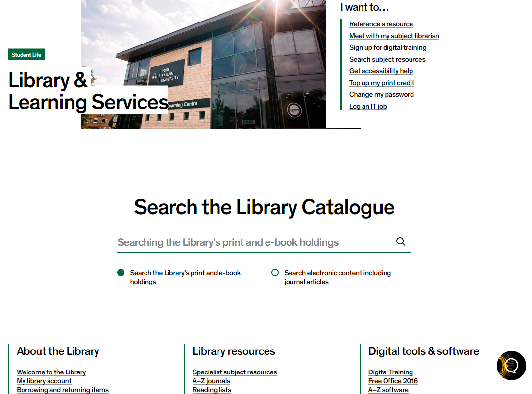
Getting started
Do you have your YSJ username and password and an internet connection?
Yes? Great. You now have access to all our electronic resources including thousands of ebooks, journal articles and databases.
www.yorksj.ac.uk/library
Notes:
Do you have your YSJ username and password? If yes, now you have access to thousands of ebooks and journal articles. We work with your academics to provide the resources relevant to your programme via our library webpages and reading lists.

Slide 4
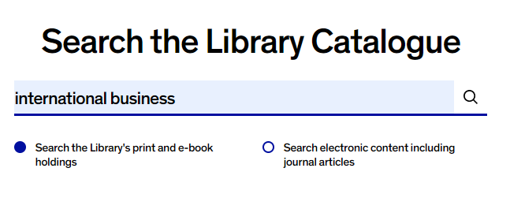
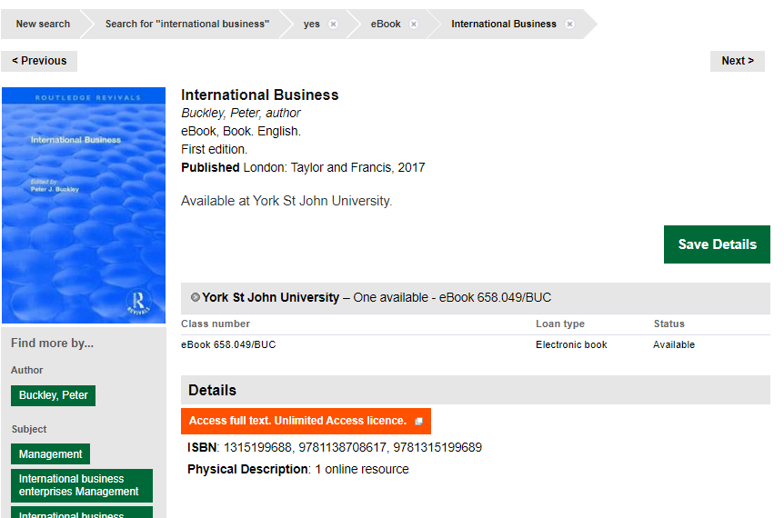
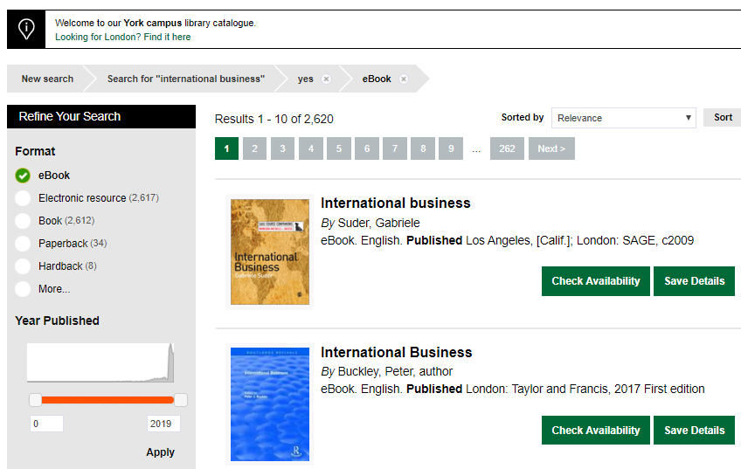
Searching for ebooks
www.yorksj.ac.uk/library
www.yorksj.ac.uk
Notes:
The Library & Learning Services page is available through the University website. Once you’ve found our page:
1. Type your search topic: 'International business' into the catalogue search bar.
2. You’ll see all your search results including print and ebooks.
Use the left side panel ‘Refine your search’ to display ebooks only which are accessible from anywhere with an internet connection.
3. Go to the ebook you wish to access and click on Access full text

Slide 5
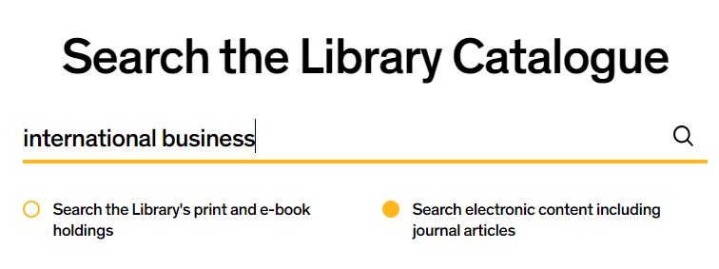
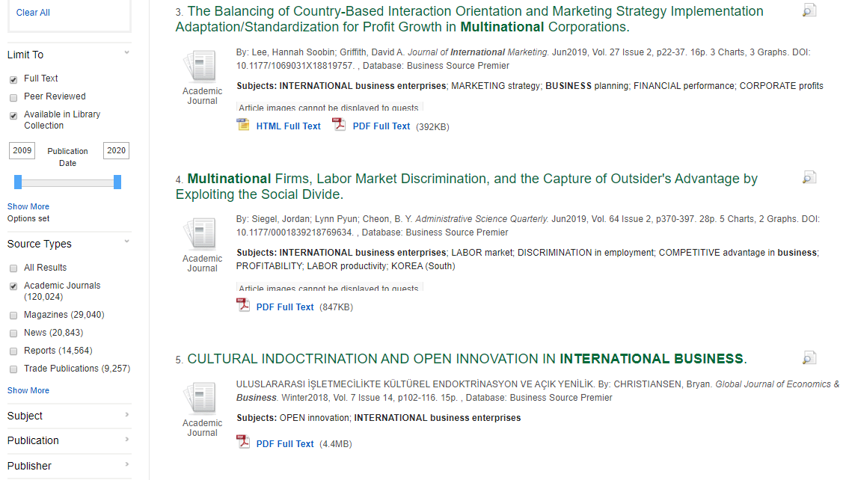
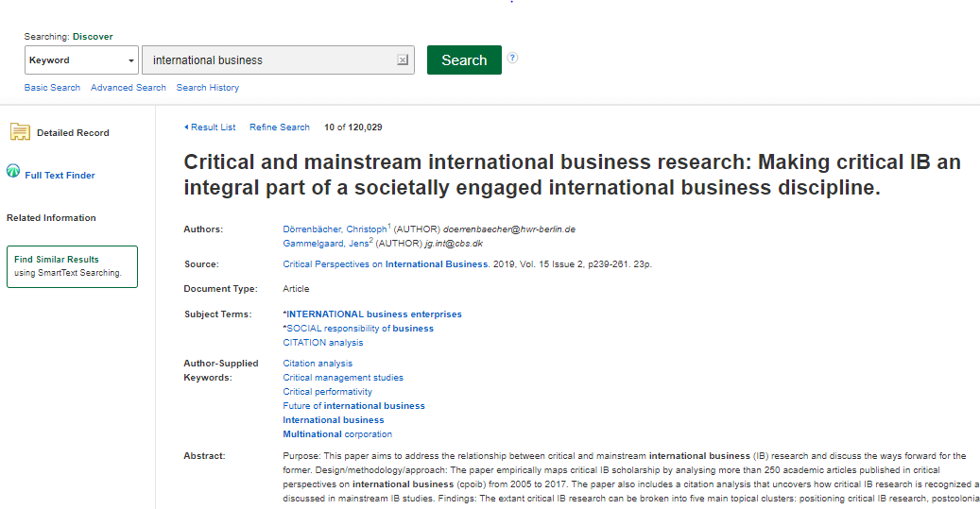
Searching for journal articles
www.yorksj.ac.uk/library
www.yorksj.ac.uk
Notes:
1. To search for journal articles, switch the catalogue search to Search electronic content including journal articles and then search for your topic of international business.
2. All electronic content including journal articles and ebooks will be displayed. Use the refine your search panel to limit your search to journal articles and recent date of publication for up to date research.
3. Display the record for a journal article and link to the full text via PDF or Full text finder link

Slide 6
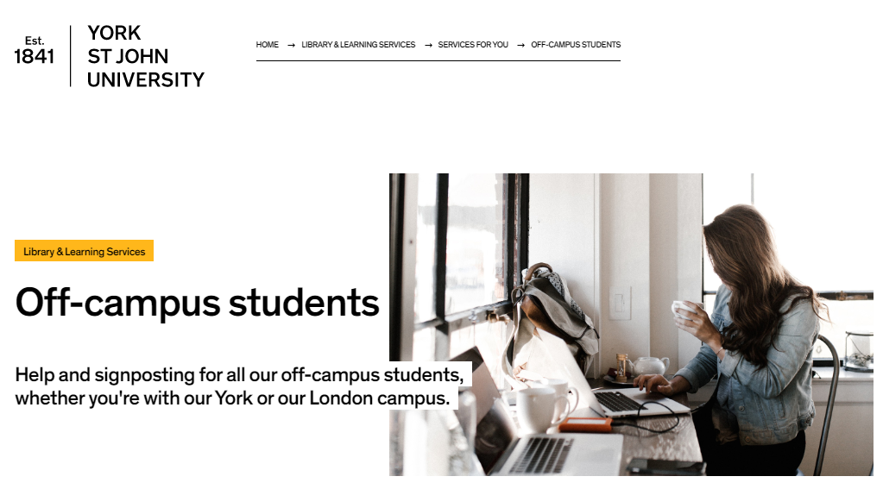
Off-campus students webpage
How to do it guides:
Link our holdings to Google Scholar
Searching for ebooks
Accessing ejournals
Search for journal articles
www.yorksj.ac.uk/library
www.yorksj.ac.uk
Notes:
There’s lots of help available on the library webpages. Browse the section Supporting your learning to find the Off–campus students page. Take time to explore our how to do it guides which show you how to access our resources remotely.

Slide 7
Contacting us
For general queries email us on ile@yorksj.ac.uk
Contact your librarian via email: academicliaisonteam@yorksj.ac.uk
As an off-campus student who might find it difficult to come and see us face-to-face go to Subject help from your librarians to book an online tutorial with your librarian
www.yorksj.ac.uk/library
www.yorksj.ac.uk
Notes:
You can find out who your librarian is for your subject area. As an off-campus student it might be difficult for you to come in to see us face to face. The academic librarians can help you by email or we can arrange an online appointment. Please book a time with your librarian using our tutorial booker.

Slide 8
Next steps
Try out a search for an ebook about your subject area
Switch to journals and search for a journal article
Go to our subject resources page, filter All subjects to your subject area
From Subject help from your librarians note the Academic Liaison Librarian email address
Please get in touch if you need help
www.yorksj.ac.uk/library
Notes:
Now you know where to start, why not try out some activities like finding ebooks or journal articles, then go to our subject databases page and have a look at some of the amazing resources we have at York St John for your subject area.
Note the email address for your Academic Liaison Librarian. Let us know if you need any help, if something is not working as you expect or if you can’t find something. We’re happy to help.

Slide 9
Thank you for watching and welcome to York St John!
www.yorksj.ac.uk/library
Notes:
Thank you for watching our video and welcome to York St John!

Slide 10
www.yorksj.ac.uk/library
www.yorksj.ac.uk

