Slide 1
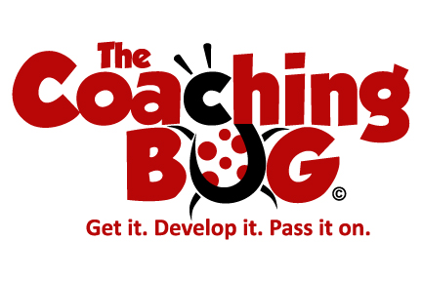

Developing Your Mentoring
Style & Approach
With Karen Hickman

Slide 2
‘Dark times lie ahead of us and there will be a time when we must choose between what is easy and what is right’
Albus Dumbledore”
J.K. Rowling, Harry Potter and the Goblet of Fire

Slide 3
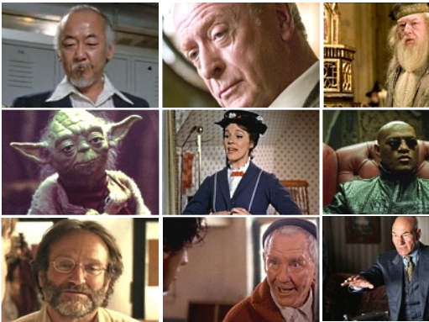

Slide 4
If you were going to be written into a film or book as the ‘mentor’ what 3 Words would the audience use to describe your style & approach?
What would be your most memorable line delivered in the story?

Slide 5
Your Style & Approach
Your natural tendency and certain approaches to life
What you have learnt over time and how you have adapted to make human relationships more comfortable

Slide 6
Your Natural Tendency
Sociability – with or apart from others
Openness - How easy it is for us to trust others
Dominance - Preference for been in charge
Chip Bell – Managers as Mentors

Slide 7
People with high sociability will find rapport building and leading dialogue easier.
They will have to work hard not to take over the conversation
People with low sociability may be more reserved and less accessible to others
They will have to work hard to open up and communicate

Slide 8
Open people are very open about themselves and are likely to develop relationships easily.
They may need to hold back a little as sharing too much too soon could be overwhelming or intimidating.
Those who are more cautious or guarded may be reluctant to show their feelings
They need to work hard on overcoming instinctive guardedness in order to take emotional and personal risks with their mentees

Slide 9
People with high dominance may be reluctant to give up control.
They need to encourage their mentee to take ownership of their issues rather than jump in and solve them for themselves
Less dominant people may need to work hard to assume leadership of the relationship, their laissez-faire approach could leave the mentee wondering if they can offer any guidance at all

Slide 10
Authoritative - More Dominant
Confronting - Being challenging
Informing - Giving information and knowledge to gain a better understanding
Prescribing - Providing direct advice, offering opinions to directly influence
John Heron (1990) - ‘Helping the Client’

Slide 11
Facilitative - Less Dominant
Catalytic - Asking probing questions to encourage self learning
Supportive - Providing encouragement and confidence building, providing approval, confirmation and validation
Cathartic - Encourage the other person to express the emotions and release tensions, empathising with them
John Heron ‘Helping the Client’ (1990) London Sage

Slide 12

Which Role?
Guru
Advisor
Challenger
Cheerleader
The Counsellor
The Influential Networker

