Slide 1
Ensure that the standards and quality of our programmes cohere with the relevant National Qualification Framework, Subject Benchmark Statements, Characteristics Statements and professional requirements
Identify good practice in learning, teaching and assessment, and areas for enhancement
Inform the continuous improvement of our programmes
External Examiners…

Slide 2
Section 42 of the University’s Code of Practice on Assessment:
To ensure that the academic standards of programmes meet the requirements of the relevant National Qualification Framework.
To ensure the value of our qualifications awarded is in line with Higher Education sector recognised standards.
To calibrate and maintain academic threshold standards for our qualifications both internally across cohorts and collaborative providers, and in relation to the broader Higher Education system.
To verify that the standards set are appropriate in the awards and modules for which they are responsible.
To ensure that the assessment procedures are fair, reliable and transparent, and that integrity is maintained in their operation.
To contribute to improvement and enhancement of core practices for standards through comment on areas of good practice, innovation and enhancement.
External Examiners key role…

Slide 3
Quality Assurance Agency (QAA) – Quality Code Advice and Guidance External Expertise
provide impartial and independent advice, as well as informative comment on the degree-awarding body’s standards and on student achievement in relation to those standards
confirm that the provider consistently and fairly implements their own policies and procedures to ensure the integrity and rigour of assessment practices
comment on the reasonable comparability of standards
comment on the maintenance and application of academic standards through internal marking practices
comment on any comparability of provision delivered internally and provision delivered to partners
External Examiners…

Slide 4
Timeline of key events
August | Semester 2 resit period Re-assessment fails reviewed by EE Concurrence provided by EE before September SAB EE reports due for programmes examined over the summer (1 August)
September | Semester 2 resit SAPs and SABs
November | Semester 3 SAPs and SABs (usually PG) EE reports due for programmes examined Sep/Oct (1 November)
December | Semester 1 Examination paper deadline University Assessment Board (Discussive UAB – Previously PAEP)
January | Semester 1 Examination/Assessment Period (end of the month)
February | EE reviews sample of work and all fails/provides concurrence Mark entry deadline for Semester 1 (e:Vision) Semester 1 SAPs and SABs
April | Semester 1 resit period (early in the month)
May | Semester 2 Examination/Assessment Period (end of Month)
June | EE reviews sample of work and all fails. Reviews Semester 1 reassessment fails. Provides concurrence. Mark entry deadline for Semester 1 resits and Semester 2 (e:Vision)
July | Semester 1 resit and Semester 2 SAPs and SABs University Assessment Board (Annual review UAB – Previously PAEP)

Slide 5
What are my key tasks?
Usually a four-year term – option to extend to five years in exceptional circumstances; new Examiners with no prior external examining experience will be appointed a mentor
External moderation:
Sample work from:
Level 5 and Level 6 (Bachelors)
Level 5, Level 6, Level 7 (integrated Masters)
Level 7 (Postgraduate)
Level 8 (Taught doctorates)
Review failed assessments (first sit and resit)
Give a view if mark disagreement following internal moderation
Review borderline marks for dissertations

Slide 6
What are my key tasks?
Other tasks:
Member of School Assessment Board (SAB) and required to endorse module results
Evaluate proposed assessments and examinations
Propose any re-marking/scaling of marks for an entire cohort
Meet with students
Give a view on the ability of students to meet the learning outcomes of a programme of study
Comment on the academic standards of provision
Consulted on module and programme amendments
Complete an Annual Report
Not involved in degree classification/ progression decisions

Slide 7
Franchise provision
Consideration of the comparability of standards across all delivery sites
Role of EE mentor
Provide support to the mentee during the first year of their appointment
Mutual agreement as to how the contact and support will operate
The Mentor is expected to offer guidance on the role of the examiner in
moderation of examination papers and providing comment on other forms of assessment
sampling of students’ work
providing advice on the subject area assessment panel (SAP) and subject assessment board (SAB)
the examiner’s completion of their annual report
The mentor should also work alongside the mentee to ensure the proper process of assessment has taken place in terms of confirmation of standards and justice to the students.
A report should be submitted by the mentor at the end of the academic session in which the mentoring has taken place along with a record of contact
What are my key tasks?

Slide 8
Assessment Committees
School Assessment Panels (SAPs)
SAPs meet prior to the meeting of the School Assessment Boards to consider and agree marks to be presented to the SAB.
School Assessment Boards (SABs)
Subject External Examiners in attendance
SABs report to the University Assessment Board and have oversight of assessment for all taught provision within the School, including ensuring assessment procedures are properly conducted, and standards assured. SABs are now approve awards and progression decisions on behalf of UAB.
University Assessment Boards (UAB)
Previously known as Progress & Award Examination Panel
Regulatory External Examiner

Slide 9
Attendance at School Assessment Boards
EE must attend at least one per year
Usually held online
Usually held in February, June, August. From 2023-24 the October board was moved to November.
SAB expectations
When will work be sent for review?
Work will be sent for review in the period after internal moderation and prior to the SAB, samples must be reviewed prior to SAB. Occasional ad-hoc concurrence may be required but kept to a minimum.
Concurrence post-SAB
If there are exceptional reasons, such as illness, that delayed concurrence being provided in time for SAB then concurrence must be sent as soon as possible after the SAB, as we are unable to agree marks for students until this is received. This may delay progression or award decisions.
Borderline grades
External Examiners will be asked to review and provide concurrence for a sample of borderline grades for first attempt UG and PG dissertations

Slide 10
Mark adjustments
Marks for individual students in the sample will not normally be adjusted unless the EE considers that there is a need to adjust the marks for the whole cohort taking the module. In these circumstances the EE can recommend a course of action to the SAB, for example, the assessment is re-marked for all students.
SAB expectations
What happens if I cannot attend?
If you are unable to attend you must notify the Programme Administration and Student Support Team (PASS) in advance of the meeting, and confirm concurrence for all modules being presented at the meeting.
Re-assessment
EE are not required to review a sample of reassessments or deferrals of passing standard.
All reassessment failures must normally be reviewed by the EE as these may lead to a student's enforced withdrawal due to failure.

Slide 11
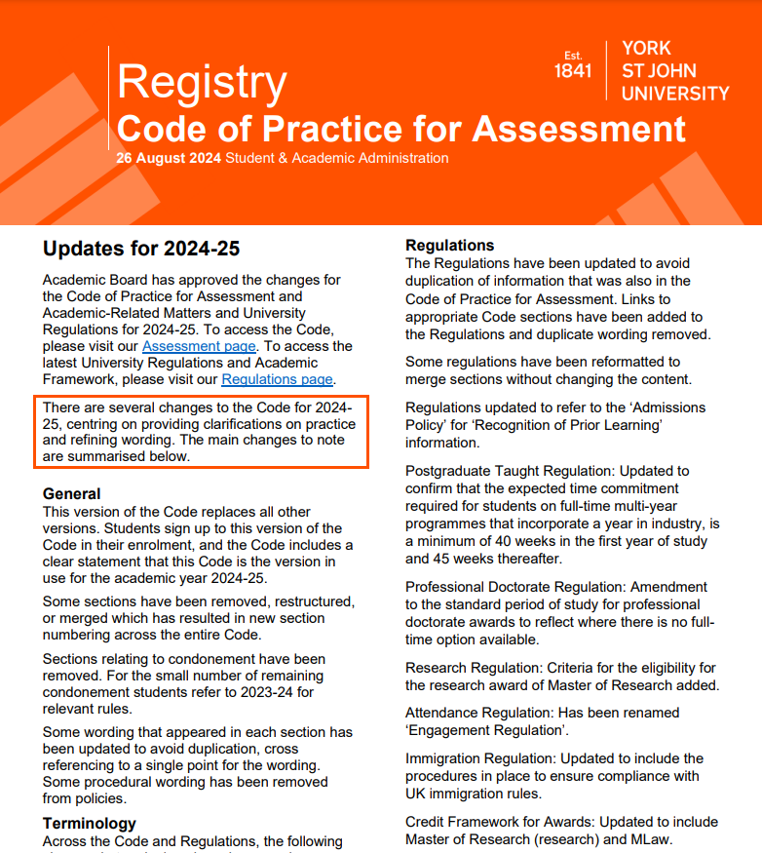
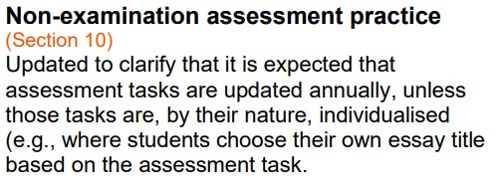
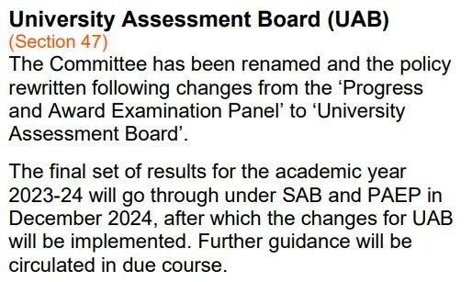
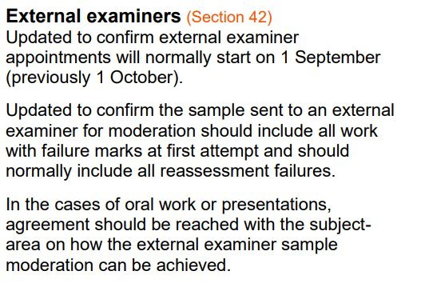
All External Examiners will have received a briefing summary of the changes implemented for 2024-25.
Assessment Processes

Slide 12
Assessment Processes
Compensation Assessment Scheme
Students who commenced their programme from 2020-21 are assessed under the ‘compensation’ assessment scheme.
This allows marginal failure to be compensated, and credit awarded if the compensation criteria are met.
Students may compensate up to 20 credits per level in the mark range 30-39 (UG) or 30 credits per programme in the mark range 45-49 (PG).
To be able to compensate failure the credit weighted average for the level/programme must be at least 40 (UG) and 50 (PG).
Students must pass all modules indicated as non-compensatable on the programme specification and all modules marked on a pass/fail basis.
Students must also meet any additional specific requirements stated on their programme specification.
Repeat study may only be recommended where a student is able to complete their studies within their maximum period of study (programme length plus 2 years).

Slide 13
Restarts (Levels 3 and 4 only)
Assessment Processes
Students in their first level of study (3 or 4) can restart their programme where they have failed 60 credits or less and might otherwise be withdrawn due to programme failure.
Students may only restart their studies once. If a level 3 student has restarted level 3, they are not able to restart at level 4.
There is no automatic right for Degree Apprenticeship students or students studying professional programmes with professional, statutory, or regulatory body requirements to restart the first year of their programme, however, the School Assessment Board (SAB) may make a recommendation for restart for individual students on these programmes.
There is no automatic right to repeat any level of study beyond the first year.
Restarts are normally agreed by the School Assessment Boards, but the decision may be made as a result of an appeal outcome or a request to the Special Cases Panel.
Repeating modules to redeem progression failure
Level 4 or 5 students who have failed up to 40 credits can repeat the failed modules in full as part time students the following year to redeem their progression failure. There are some programmes where repeating part time is not permitted, this is stated on the programme specification.
There is no automatic right to repeat a module at other levels.
Repeat study may only be recommended where a student is able to complete their studies within their maximum period of study (programme length plus 2 years).

Slide 14
Special Cases Panel
Considers individual student cases on behalf of the University Assessment Board where a School requests the Panel to vary the decision it would otherwise make.
Considers recommendation based on unclear or uncertain exceptional circumstances to allow students to continue or progress on a programme of study.
Ensures regulations are applied properly and consistently.
Made up of a representative from each School.
Assessment Processes
Exceptional Circumstances Policy
Process is evidence-based.
Students can request a 3-week extension with evidence.
Students can request a deferral to the next assessment period where they are unfit to attend a scheduled assessment or where they need longer than 3 weeks.
Students can self-certify for 1-week per semester without evidence.

Slide 15
Assessment Processes
Academic Misconduct Regulations
Appeal and Conduct Committee (ACC) is a committee of academics who review appeals and academic misconduct cases.
The School investigation will establish if no further action is taken, if it is a case of poor scholarship or if it is a case of academic misconduct. Where it is established to be a case of academic misconduct, all the evidence is forwarded to ACC for review with a recommended penalty.
ACC will review the case and consider whether the evidence is sufficient to justify the conclusion the student has committed academic misconduct, and if so, whether the proposed penalty is appropriate considering all the evidence and in accordance with the guidelines in the policy.

Slide 16
Reports
Completion of reports
Report form comprising five sections:
Part A: External Examiner details;
Part B: Full Report; Learning, Teaching and Student Experience Strategy; Professional, Statutory, Regulatory Body (PSRB) Requirements; Apprenticeship Requirements
Complete by 1 August (for programmes examined in the summer) or 1 November (for programmes examined in September/October)
Where appropriate, reports include consideration of franchise provision
Reports inform our quality improvement and feed into the University’s annual monitoring process
Reports are made available to students

Slide 17
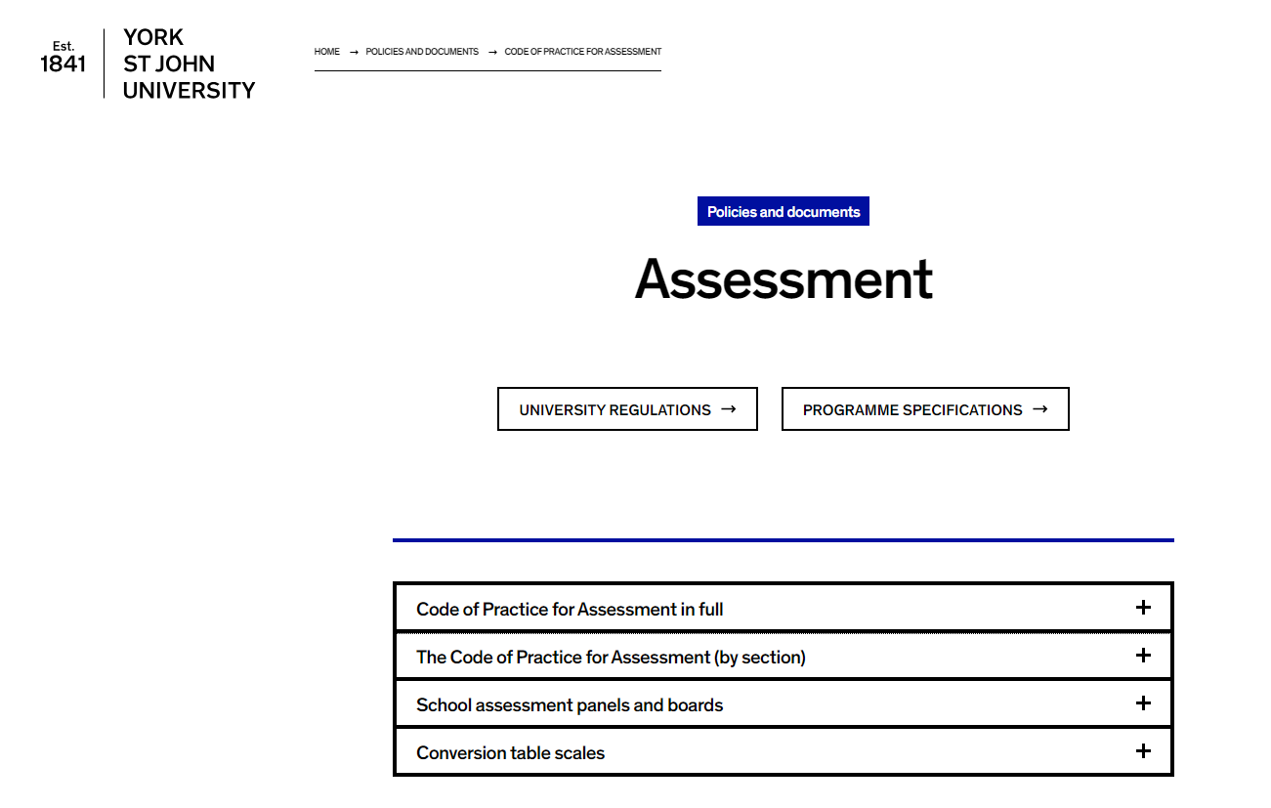
What do I need and where do I find it?
Information for external examiners | York St John University (yorksj.ac.uk)​
Moodle – External Examiner Access to Student Work​
Regulations | York St John University (yorksj.ac.uk)​
Code of practice for assessment | York St John University (yorksj.ac.uk)​
42.External-Examiners-for-Taught-Programmes-2024-25.pdf (yorksj.ac.uk)​
External Expertise (qaa.ac.uk)​
Key academic dates

Slide 18
Who could I talk to?
externalexaminers@yorksj.ac.uk​
​
Programme Administration and Support Service:​
Contact us | York St John University (yorksj.ac.uk)​
​
Technology Enhanced Learning (Moodle):​
tel@yorksj.ac.uk

Slide 19
Any Questions?

