Slide 1
Who we are
The final strategy:
The University for Social Impact
Our Heritage
York St John University has been passionately promoting education for social and civic benefit for almost two hundred years. We are proud of our heritage, our church foundation, and our pioneering education of women. We celebrate our growing and diverse community of all faiths and none. As a mid-sized university with a main campus and sports park in York, and a London campus near Canary Wharf, our estate now provides a welcoming, safe, inclusive, and inspirational learning and teaching environment to over 12,000 students.
Strategy launch, including design assets and changes to our
website
Close down of Strategy 2026, baselining of new strategy measures of success, realignment of risk register, etc
Development of underlying plans
Reporting on progress of new strategy

Slide 2
The final strategy:
Who we are
Our Heritage
York St John University has been passionately promoting education for social and civic benefit for almost two hundred years. We are proud of our heritage, our church foundation, and our pioneering education of women. We celebrate our growing and diverse community of all faiths and none. As a mid-sized university with a main campus and sports park in York, and a London campus near Canary Wharf, our estate now provides a welcoming, safe, inclusive, and inspirational learning and teaching environment to over 12,000 students.
Driven by Social Justice
Our historic commitment to social justice underpins all our actions and decision-making. We take an active stand against climate change, prejudice, and all forms of inequality. As a civic university, we play a vital role in the economic and social prosperity of the regions we serve. We are proactive in local, national and international contexts, and make an important social impact through our research, partnerships and development of professionals for the future. Our strategy will meet future challenges by guiding the innovation and energy of our university community.
The University for Social Impact

Slide 3
Who we are
Driven by Social Justice
Our historic commitment to social justice underpins all our actions and decision-making. We take an active stand against climate change, prejudice, and all forms of inequality. As a civic university, we play a vital role in the economic and social prosperity of the regions we serve. We are proactive in local, national and international contexts, and make an important social impact through our research, partnerships and development of professionals for the future. Our strategy will meet future challenges by guiding the innovation and energy of our university community.
Our Heritage
York St John University has been passionately promoting education for social and civic benefit for almost two hundred years. We are proud of our heritage, our church foundation, and our pioneering education of women. We celebrate our growing and diverse community of all faiths and none. As a mid-sized university with a main campus and sports park in York, and a London campus near Canary Wharf, our estate now provides a welcoming, safe, inclusive, and inspirational learning and teaching environment to over 12,000 students.
What we are proud of
We are exceptionally proud to be TEF Gold for student experience, and Silver overall. Our focus on excellence has supported our upward trajectory on key quality parameters, including entry standards, continuation, outcomes, and progression. Applications to study at York St John from undergraduate and international students have grown year-on-year. We are building our research capacity after our best-ever REF outcome in 2022. Our carbon reduction and biodiversity achievements are sector-leading.

Slide 4
Our vision
Who we are
What we are proud of
We are exceptionally proud to be TEF Gold for student experience, and Silver overall. Our focus on excellence has supported our upward trajectory on key quality parameters, including entry standards, continuation, outcomes, and progression. Applications to study at York St John from undergraduate and international students have grown year-on-year. We are building our research capacity after our best-ever REF outcome in 2022. Our carbon reduction and biodiversity achievements are sector-leading.
Our values
Driven by Social Justice
Our historic commitment to social justice underpins all our actions and decision-making. We take an active stand against climate change, prejudice, and all forms of inequality. As a civic university, we play a vital role in the economic and social prosperity of the regions we serve. We are proactive in local, national and international contexts, and make an important social impact through our research, partnerships and development of professionals for the future. Our strategy will meet future challenges by guiding the innovation and energy of our university community.

Slide 5
Who we are
Our strategic aims
Our vision
Through our excellent education and research, we will be a catalyst for change, that creates a fair future.
Our values
At York St John we strive for what we believe in. Our strong values remain unchanged and underpin everything we do. We are:
Intellectually open, rigorous and curious
Dedicated to promoting fairness and challenging prejudice
Always inspiring and supporting each other to succeed.
What we are proud of
We are exceptionally proud to be TEF Gold for student experience, and Silver overall. Our focus on excellence has supported our upward trajectory on key quality parameters, including entry standards, continuation, outcomes, and progression. Applications to study at York St John from undergraduate and international students have grown year-on-year. We are building our research capacity after our best-ever REF outcome in 2022. Our carbon reduction and biodiversity achievements are sector-leading.

Slide 6
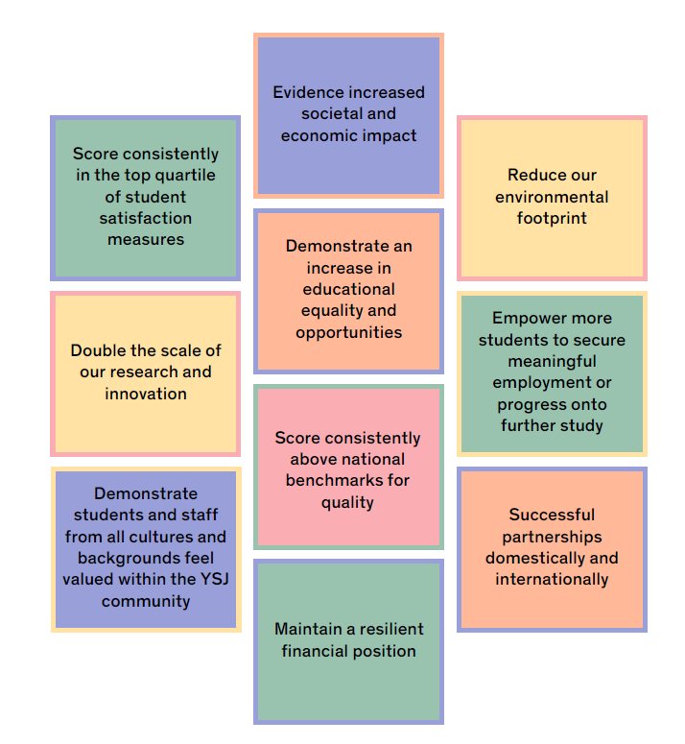
Our strategic aims
Our vision
York St John will:
Celebrate our locations in York and London whilst being global in outlook.
Enrich our research and the experience of students, staff and communities through transformational partnerships.
Be a truly inclusive and equitable organisation.
Collaborate with confident, authentic, resilient, enterprising and professional students and staff.
Offer a future-focused, high-quality academic portfolio with distinctive learning and teaching.
Provide all students with a personalised learning journey underpinned with technology.
Produce conscientious graduates who fulfil future skills requirements both domestically and internationally.
Be a sector leader in environmental sustainability with a whole-university approach.
Innovate through impactful research and knowledge exchange.
Demonstrate local, national and international social impact.
Our values
Our indicators of success

Slide 7
Our strategic aims
Our vision
Our indicators of success
Our values

Slide 8
What comes next?
Measures of success
Determine strategy launch date and create design assets including changes to our
website
Close down of Strategy 2026, baselining of new strategy measures of success, realignment of risk register, etc
Development of underlying plans
Reporting on progress of new strategy

Slide 9
Measures of success
Implementing the strategy
Four Strategic Frameworks
Learning, Teaching & Student Experience
Research & Innovation
Financial Sustainability
Equality, Diversity & Inclusion
School roadmaps
One per School
Common themes followed by local contextualisation
Path to 2030
- Priority focus in each academic year
- Working through how we ensure actions across the different frameworks, roadmaps and plans work together
Thank you
Professional Services enabling plans
- To support the delivery of roadmaps, frameworks and overarching Strategy

Slide 10
What comes next?
Thank you
Determine strategy launch date and create design assets including changes to our
website
Close down of Strategy 2026, baselining of new strategy measures of success, realignment of risk register, etc
Development of underlying plans
Reporting on progress of new strategy

