Slide 1
Welcome to York St John University
Presented by Staff Name

Slide 2
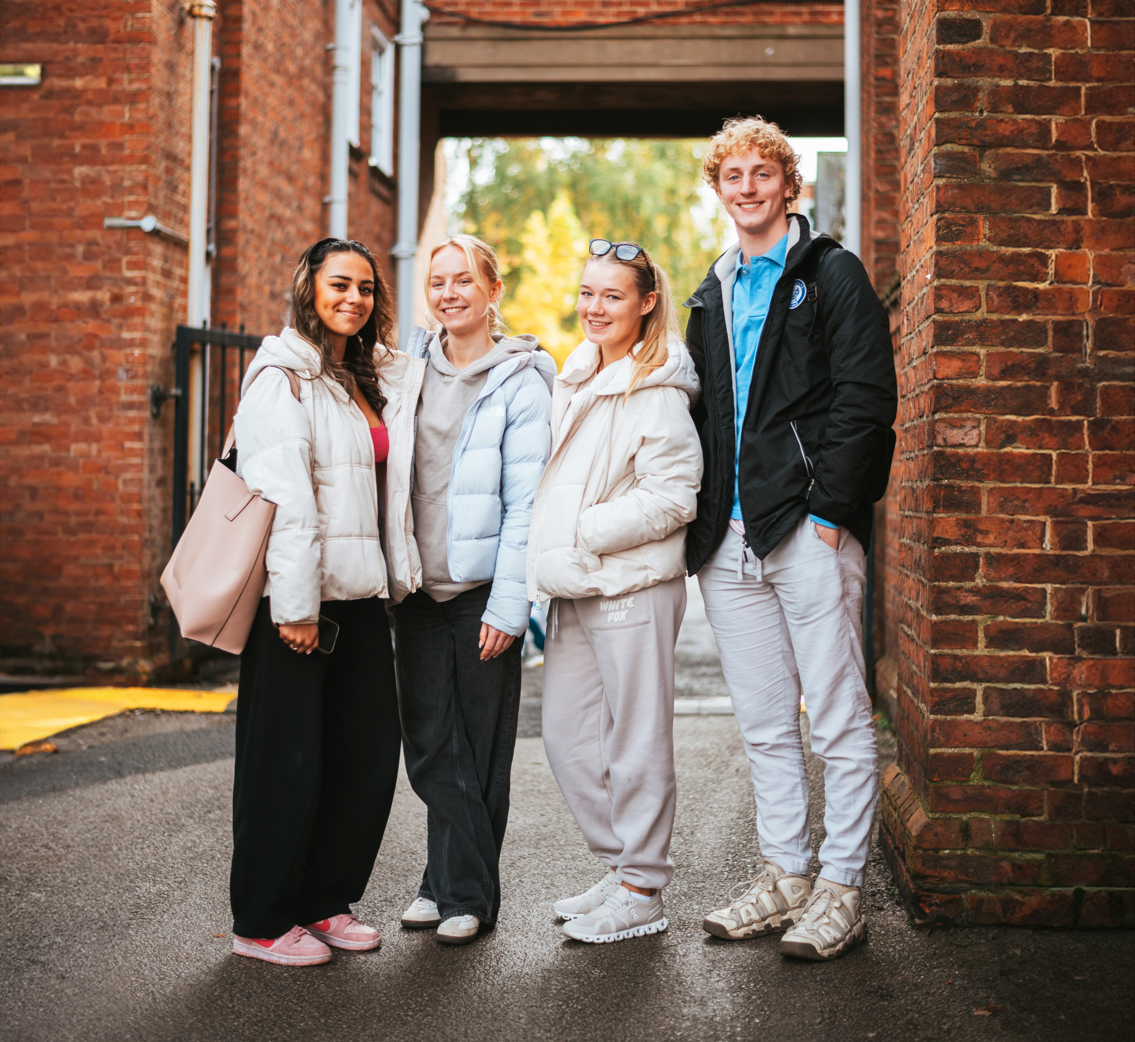
Where you can be yourself
York St John University has been named as the University of the Year for Social Inclusion by The Times and The Sunday Times Good University Guide 2025.
The award was given in recognition of our commitment to empowering students from all backgrounds with the opportunity to study and thrive in higher education.
Find out more at
yorksj.ac.uk/social-inclusion

Slide 3
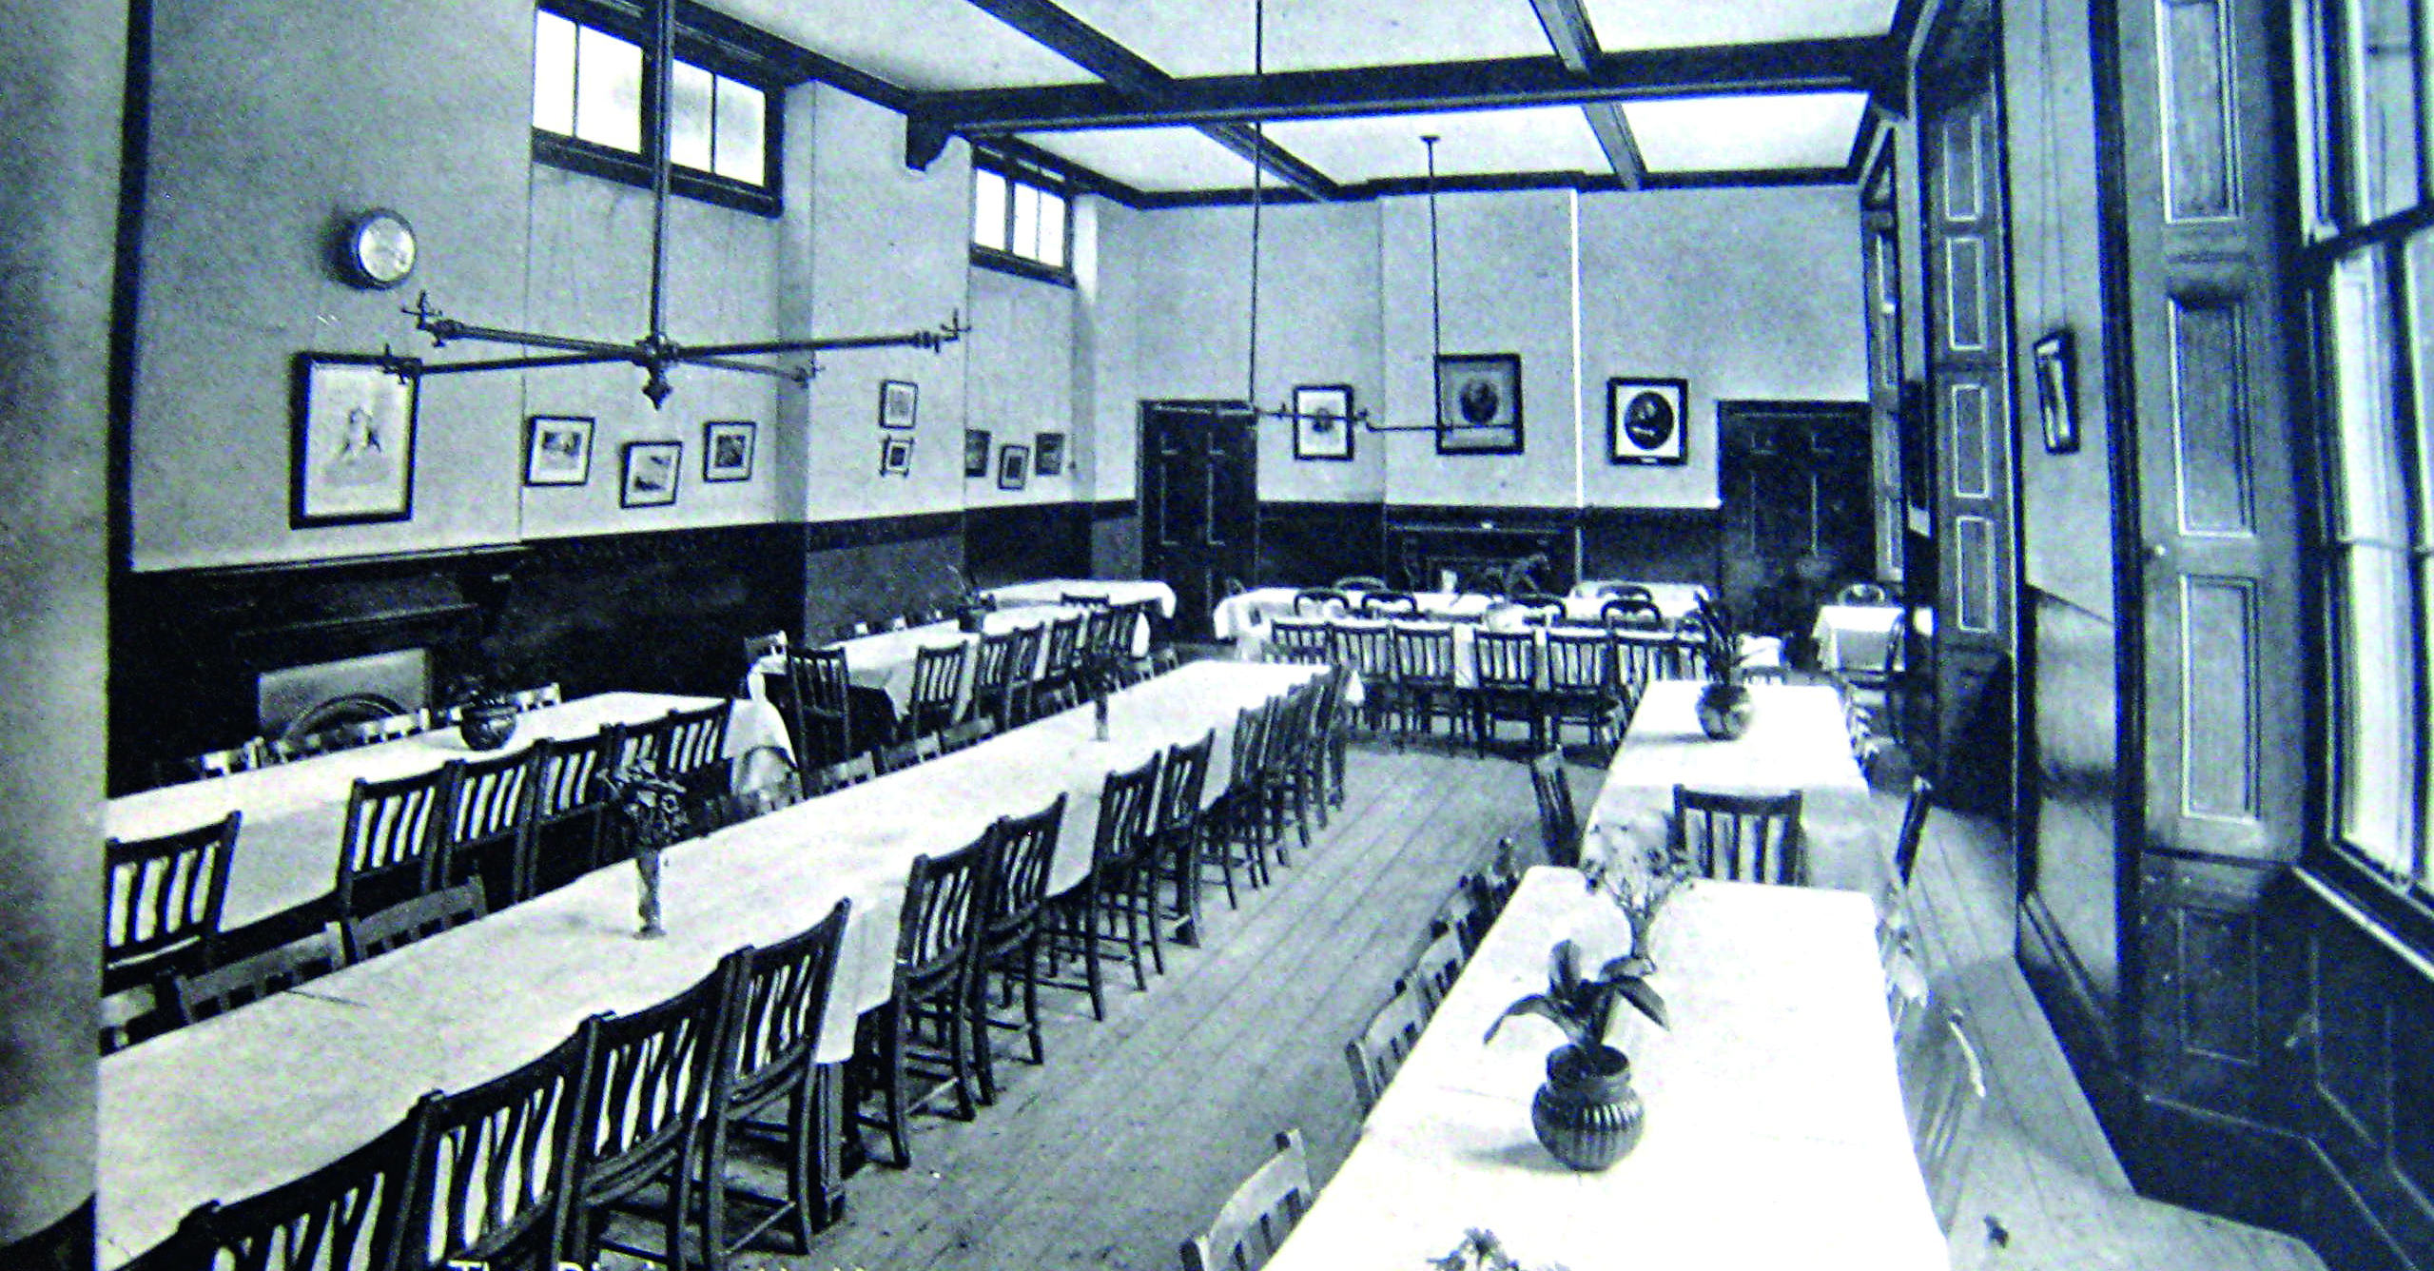
About us
Our history
Founded in 1841 York St John University has been at the forefront of Higher Education for over 175 years.
In 1841 and for the next 134 years the college’s primary role was the training of schoolteachers. Students could enter the college at 15 years old. The age of entry was raised to 17 in 1844. By 1842 there were 11 students.
At York St John University we pride ourselves on our community and heritage.
We have been teaching people from across the world for 180 years. We are passionate about giving our students a teaching and learning environment that is safe, exciting, inclusive and inspirational.

Slide 4
180
Top 5
years of teaching people from across the world in the heart of York
We are top 5 in the North East for academic support
(NSS 2024)

Slide 5
Title 5
Founded in 1841, we transform lives through the power of education across the generations.
At York St John University we pride ourselves on our community and heritage.
We have been teaching people from across the world for 180 years. We are passionate about giving our students a teaching and learning environment that is safe, exciting, inclusive and inspirational.
With official 'Sanctuary' status, we also see our role as something bigger than an education provider. Our role in the city of York is one we take seriously. Many of our students and staff are activists, engaging directly with our wider community.

Slide 6
Title 6
180
years of teaching people from across the world in the heart of York
Founded in 1841, we transform lives through the power of education across the generations.
We have been teaching people from across the world for 180 years. We are passionate about giving our students a teaching and learning environment that is safe, exciting, inclusive and inspirational.
With official 'Sanctuary' status, we also see our role as something bigger than an education provider. Our role in the city of York is one we take seriously. Many of our students and staff are activists, engaging directly with our wider community.
95%
Of our students were in work or further study 15 months after graduation
(Higher Education Graduate Outcomes Data, 2021)
Joint 1st
For carbon reduction among UK universities
(People and Planet Green League 2022)

Slide 7
Title 7
1
We pride ourselves in our community here at York St John University. It’s a close-knit, inclusive place that offers a lot more than a degree certificate.
2
Our role in the city of York is one we take seriously. Many of our students engage directly with the wider community across so many different levels. From prison partnerships to working with disabled athletes, we fight to remove the hurdles that prevent participation.
We have been teaching people from across the world for 180 years. We are passionate about giving our students a teaching and learning environment that is safe, exciting, inclusive and inspirational.
With official 'Sanctuary' status, we also see our role as something bigger than an education provider. Our role in the city of York is one we take seriously. Many of our students and staff are activists, engaging directly with our wider community.
3
Our passion for teaching, learning and commitment to our students is demonstrated through our 3 strategic priorities; Inspiring learning, Impactful research and Enabling our students to be clear about career
4
Many of our academics are also activists, taking on the challenges of the modern world head on. Our community takes an active stand against climate change, prejudice and inequality and we will only ever increase our efforts.
5
We value the social and cultural diversity that everyone brings to our community. We continuously strive to enrich our community by tackling inequalities, promoting fairness and challenging prejudice.

Slide 8
Title 8
We pride ourselves in our community here at York St John University. It’s a close-knit, inclusive place that offers a lot more than a degree certificate.
Our role in the city of York is one we take seriously. Many of our students engage directly with the wider community across so many different levels. From prison partnerships to working with disabled athletes, we fight to remove the hurdles that prevent participation.
Our passion for teaching, learning and commitment to our students is demonstrated through our 3 strategic priorities; Inspiring learning, Impactful research and Enabling our students to be clear about career
180 years of teaching people from across the world in the heart of York

Slide 9
Section title
Section subheading

Slide 10
YSJ
Our role in the city of York is one we take seriously. Many of our students engage directly with the wider community across so many different levels. From prison partnerships to working with disabled athletes, we fight to remove the hurdles that prevent participation.
I have made friends for life and people I don't think I could live without. I've met so many different people during my time here, some who have opened my eyes and changed my viewpoints on many aspects of the world. If you have a problem, or just need someone to talk to there are always people there. Even your lecturers will gladly meet you and have a coffee with you whilst you chat away!
Megan | Childhood and Youth Studies

Slide 11
I have made friends for life and people I don't think I could live without. I've met so many different people during my time here.
Megan | Childhood and Youth Studies
I have made friends for life and people I don't think I could live without. I've met so many different people during my time here.
Megan | Childhood and Youth Studies
I have made friends for life and people I don't think I could live without. I've met so many different people during my time here.
Megan | Childhood and Youth Studies
I have made friends for life and people I don't think I could live without. I've met so many different people during my time here.
Megan | Childhood and Youth Studies

Slide 12
Title 12
Campus Attendance
We have been teaching people from across the world for 180 years. We are passionate about giving our students a teaching and learning environment that is safe, exciting, inclusive and inspirational.
With official 'Sanctuary' status, we also see our role as something bigger than an education provider. Our role in the city of York is one we take seriously. Many of our students and staff are activists, engaging directly with our wider community.

