Slide 1


Welcome to
York St John
University London

Slide 2


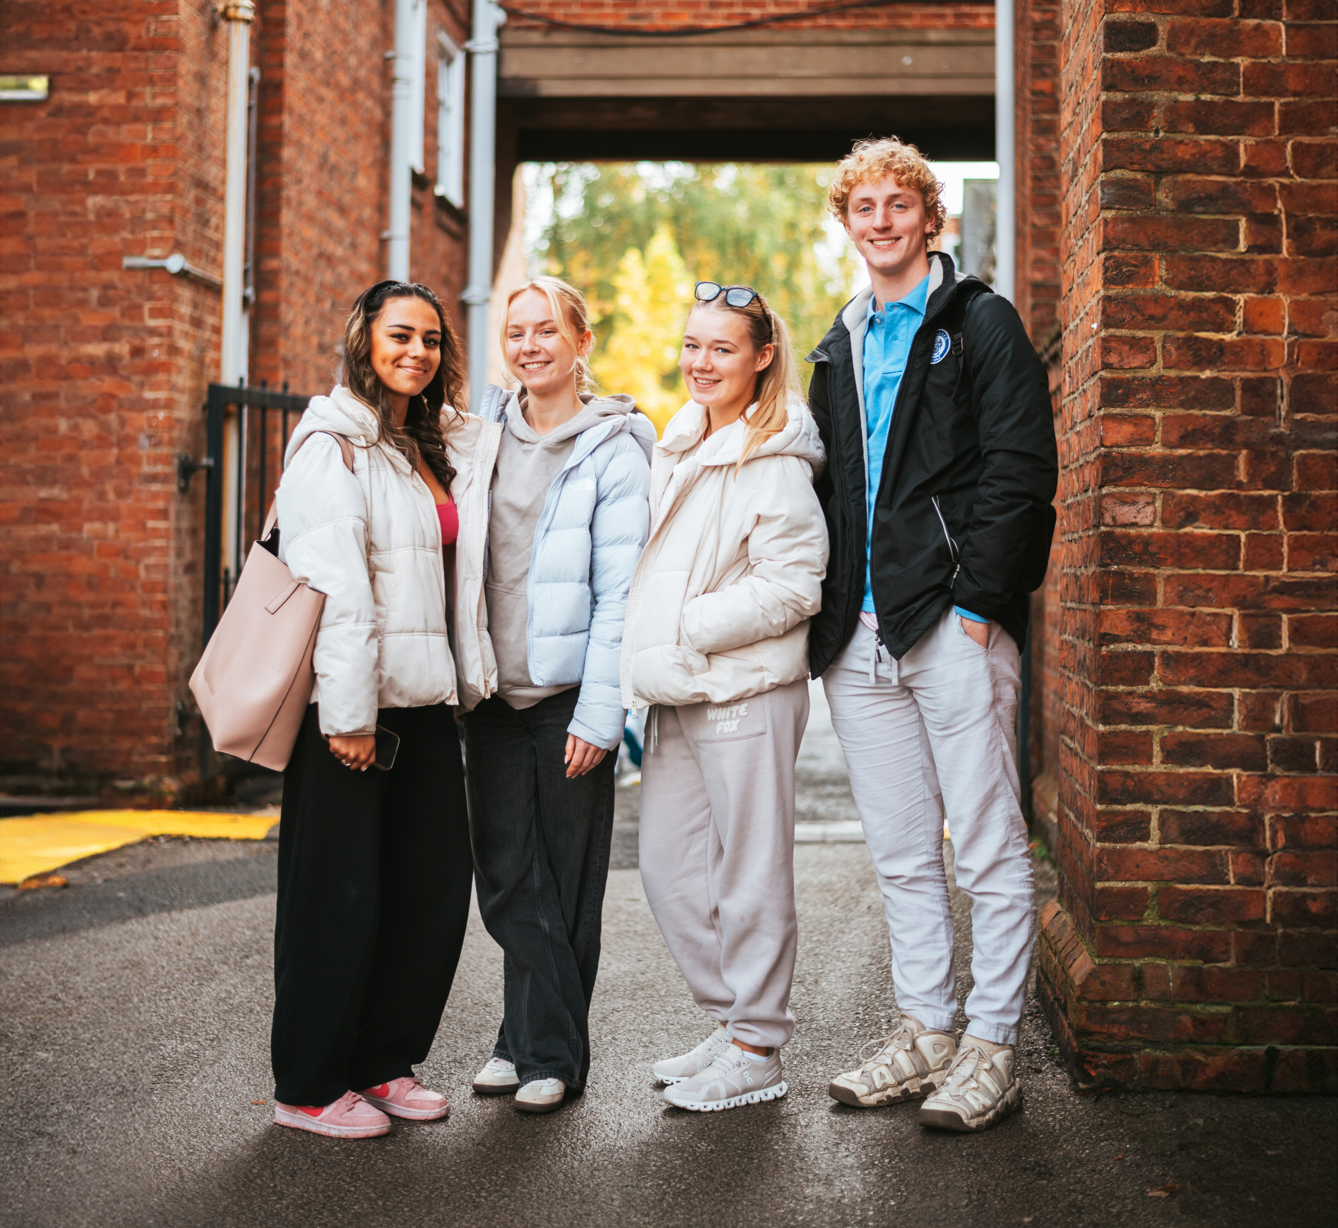
Where you can be yourself
York St John University has been named as the University of the Year for Social Inclusion by The Times and The Sunday Times Good University Guide 2025.
The award was given in recognition of our commitment to empowering students from all backgrounds with the opportunity to study and thrive in higher education.
Find out more at
yorksj.ac.uk/social-inclusion

Slide 3

Slide 1
Bullets points
Bullets points
Bullets points
Bullets points

Slide 4
Slide 2
Bullets points
Bullets points
Bullets points
Bullets points

Slide 5

Slide 3
Bullets points
Bullets points
Bullets points
Bullets points

Slide 6

Slide 4
Bullets points
Bullets points
Bullets points
Bullets points

Slide 7

Slide 5
Bullets points
Bullets points
Bullets points
Bullets points

Slide 8

Slide 6
Bullets points
Bullets points
Bullets points
Bullets points

Slide 9

Slide 7
Bullets points
Bullets points
Bullets points
Bullets points

Slide 10

Slide 8
Bullets points
Bullets points
Bullets points
Bullets points

Slide 11

Slide 9
Bullets points
Bullets points
Bullets points
Bullets points

Slide 12

Slide 10
Bullets points
Bullets points
Bullets points
Bullets points

Slide 13

Slide 11
Bullets points
Bullets points
Bullets points
Bullets points

Slide 14

Slide 12
Bullets points
Bullets points
Bullets points
Bullets points

Slide 15

Slide 13
Bullets points
Bullets points
Bullets points
Bullets points

Slide 16

Slide 14
Bullets points
Bullets points
Bullets points
Bullets points

