Slide 1
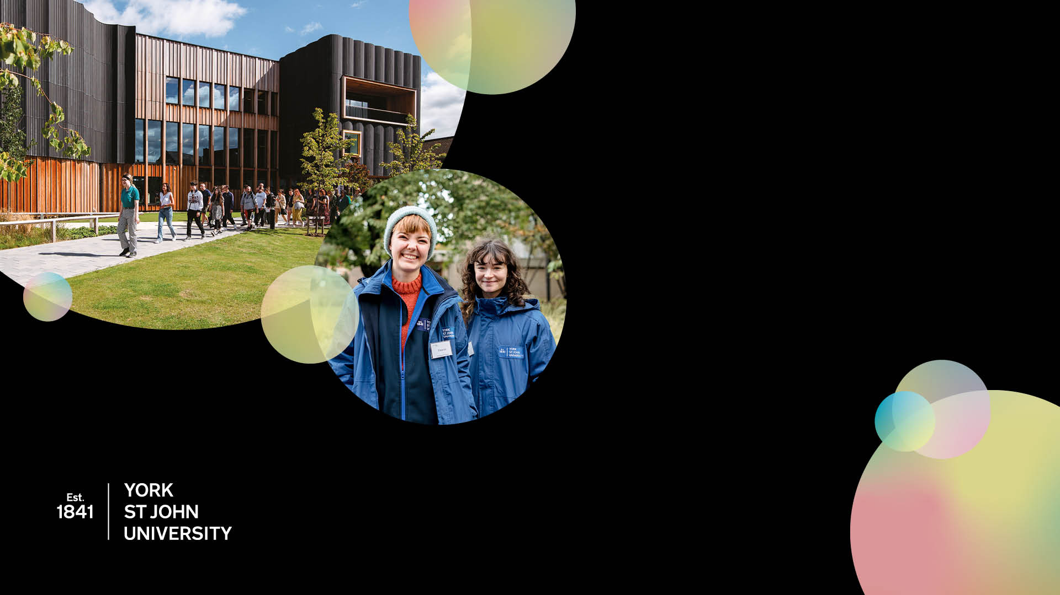
York St John University
Sunburst PowerPoint

Slide 2

Sunburst PowerPoint
We are growing and thriving This is a great time to join us
We are taking positive steps to reduce the barriers which hold people back.
We want to make a difference.
We believe in standing up for a fairer, more inclusive society. Our research and community projects reflect that.

Slide 3

Sunburst PowerPoint
We are growing and thriving This is a great time to join us
    We are taking positive steps to reduce the barriers which hold people back.
    We want to make a difference.
    We believe in standing up for a fairer, more inclusive society. Our research and community projects reflect that.

Slide 4

Sunburst PowerPoint
We are growing and thriving This is a great time to join us
    We are taking positive steps to reduce the barriers which hold people back.
    We want to make a difference.
    We believe in standing up for a fairer, more inclusive society. Our research and community projects reflect that.

Slide 5

Sunburst PowerPoint
We are growing and thriving This is a great time to join us
    We are taking positive steps to reduce the barriers which hold people back.
    We want to make a difference.
    We believe in standing up for a fairer, more inclusive society. Our research and community projects reflect that.

Slide 6

Sunburst PowerPoint
We are growing and thriving This is a great time to join us
    We are taking positive steps to reduce the barriers which hold people back.
    We want to make a difference.
    We believe in standing up for a fairer, more inclusive society. Our research and community projects reflect that.

Slide 7

Sunburst PowerPoint
We are growing and thriving This is a great time to join us

Slide 8

Sunburst PowerPoint
We are growing and thriving This is a great time to join us

