Slide 1
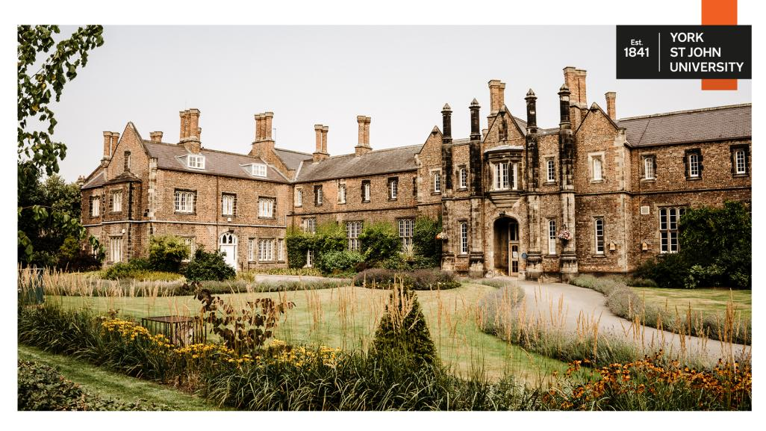

Slide 1

Slide 2


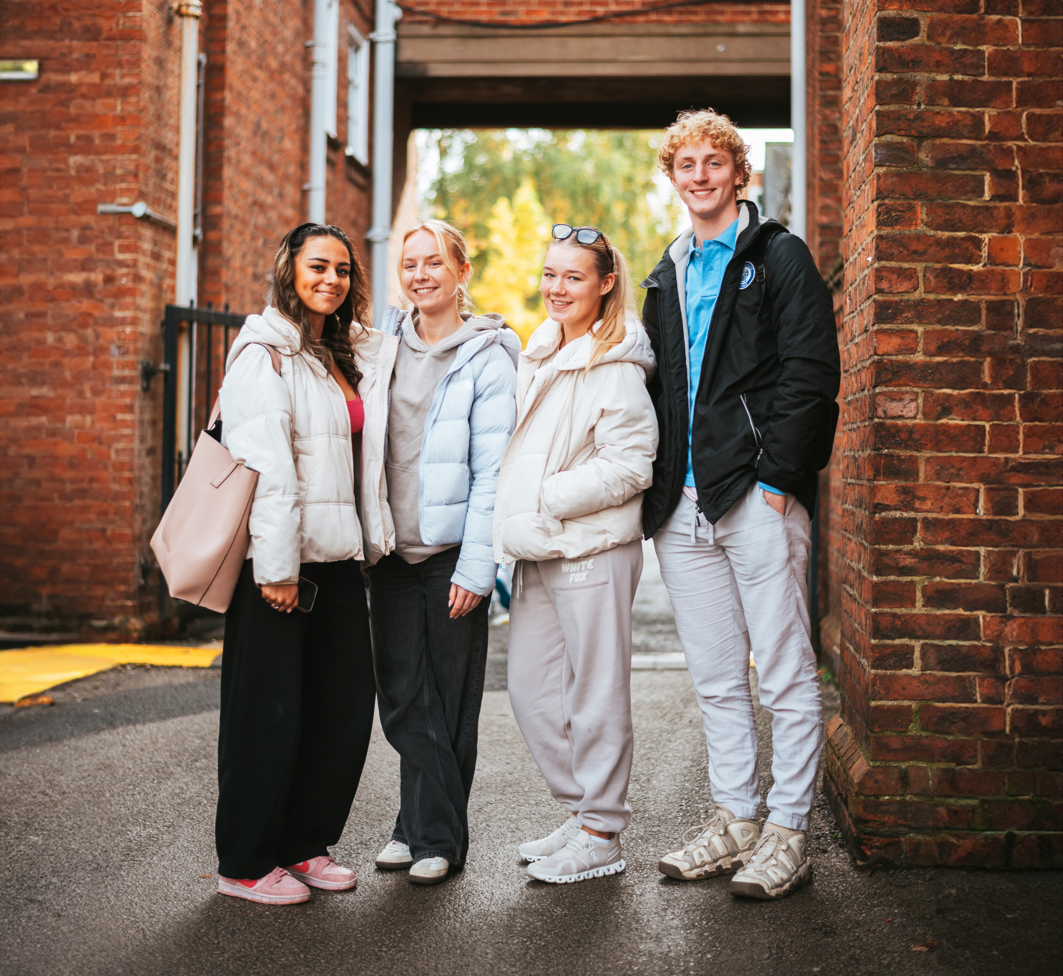
Where you can be yourself
York St John University has been named as the University of the Year for Social Inclusion by The Times and The Sunday Times Good University Guide 2025.
The award was given in recognition of our commitment to empowering students from all backgrounds with the opportunity to study and thrive in higher education.
Find out more at
yorksj.ac.uk/social-inclusion

Slide 3
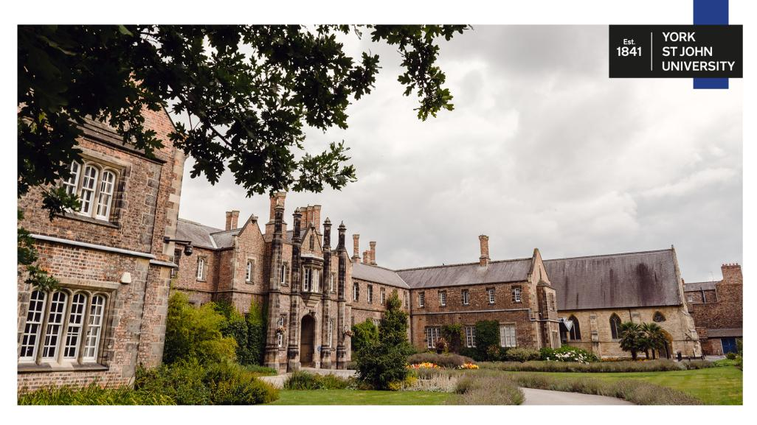
Slide 3

Slide 4
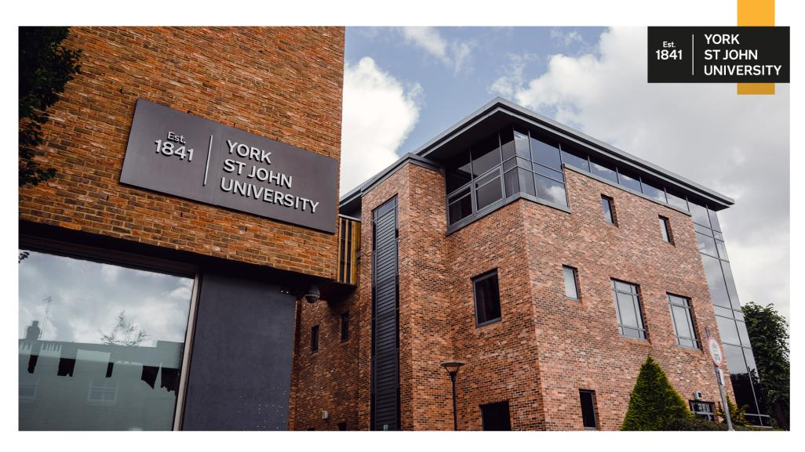
Slide 4

Slide 5
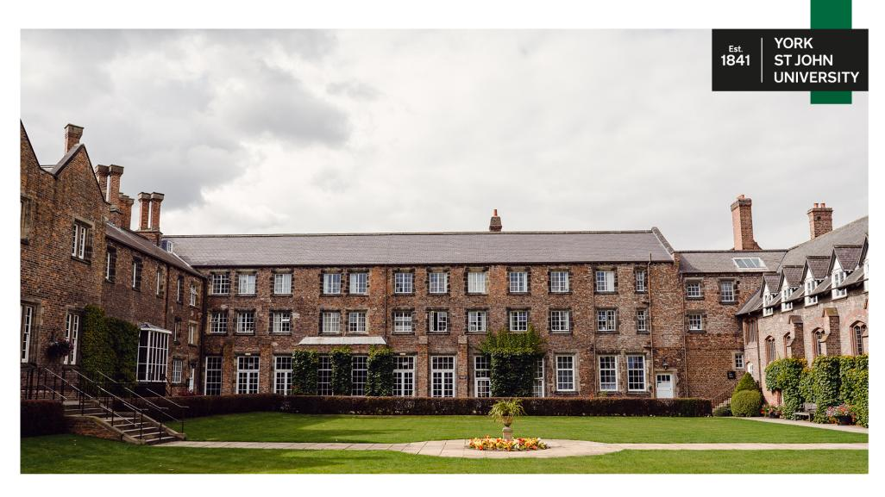
Slide 5

Slide 6

Slide 6

Slide 7

Slide 7

Slide 8
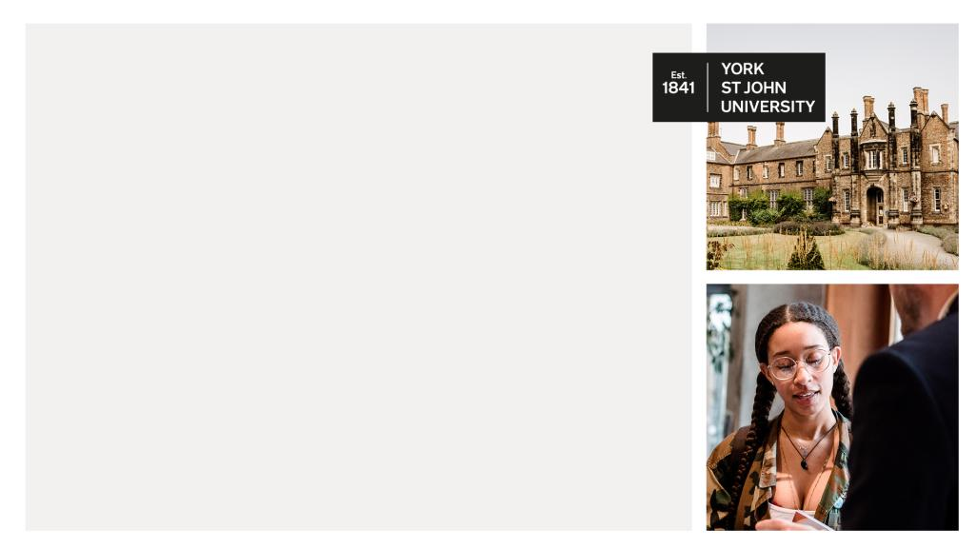
Slide 8

Slide 9

Slide 9

Slide 10

Slide 10

Slide 11

Slide 11

Slide 12
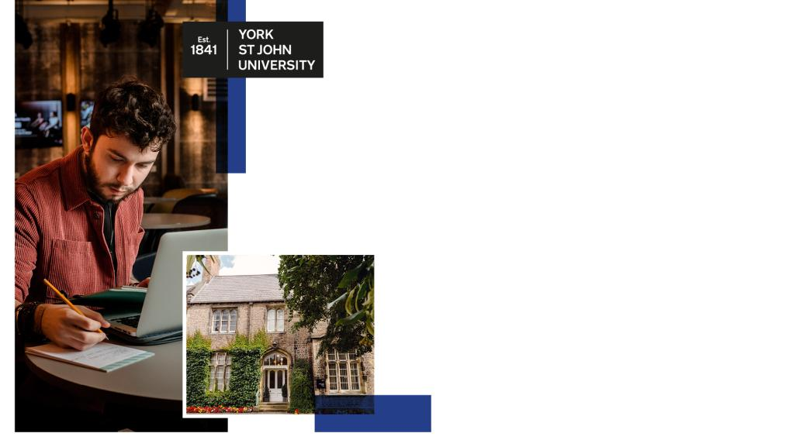
Slide 12

Slide 13

Slide 13

Slide 14
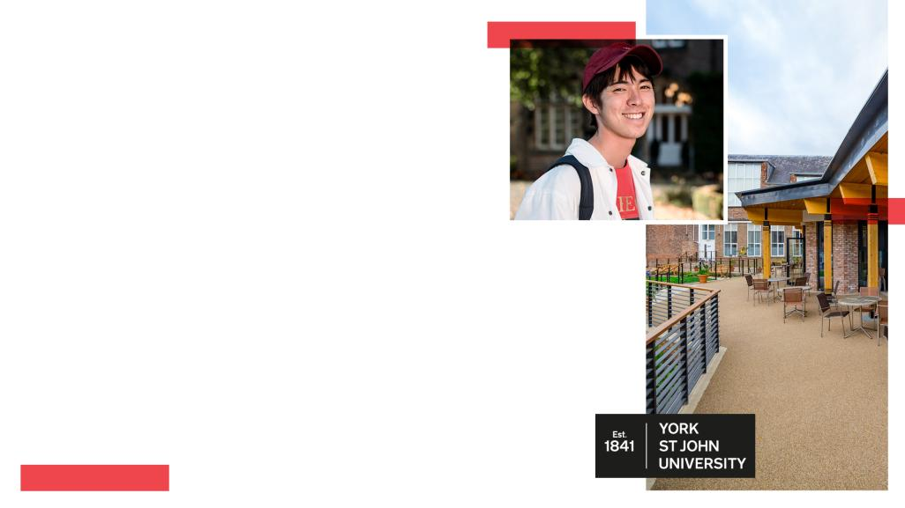
Slide 14

Slide 15

Slide 15

Slide 16

Slide 16

Slide 17

Slide 17

Slide 18

Slide 18

Slide 19

Slide 19

Slide 20

Slide 20

Slide 21

Slide 21

Slide 22
Slide 22
title | title | title | title | title
Text | text | text | text | text
text | Text | Text | Text | text
text | Text | Text | Text | text

